Slide 1
Scheme For Farmers Kiran Tonpe Vivita Dias Nikhil Jain Anne Rajan

Slide 2
Problem Statement
Farm-Scheme is a project in Agriculture domain. It is a Java Web-based application which gives an idea to the farmers how to use e-farming to sell their products. Farmers will get new ideas to improve their productivity, they can buy and sell their products online from different cities through the process of bidding. Farmers can use this facility and avail benefits of different schemes available which will increase their profit.

Slide 3
Modules
Farmer
Farmer Registration
Place Sell Request
View Sold History
View Market Place
Apply For Insurance
Claim For Insurance
Bidder
Bidder Registration
Crop Details
Admin
Admin Dashboard

Slide 4
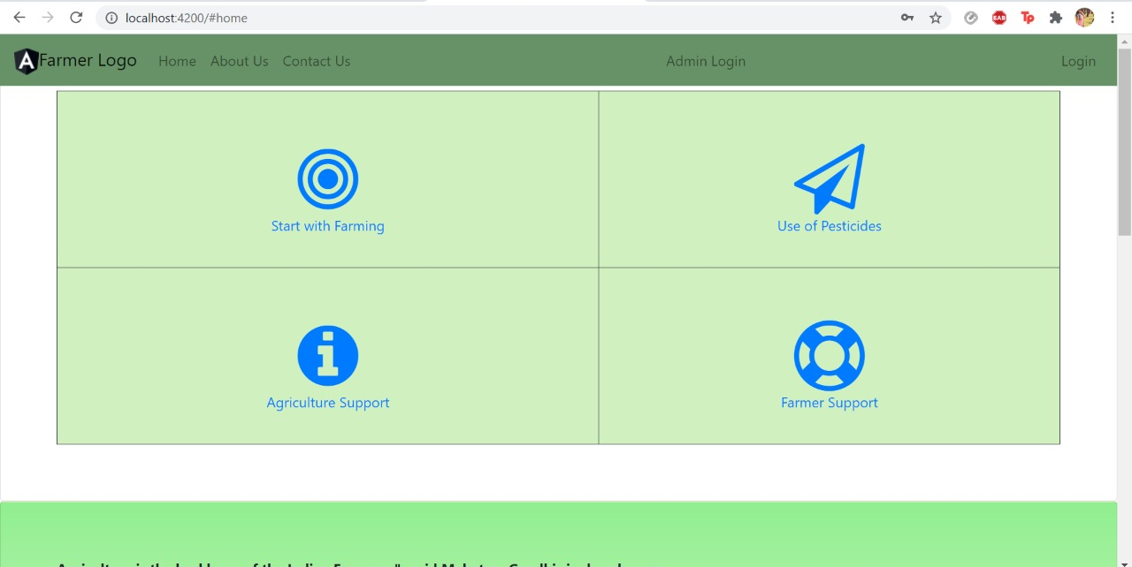

Slide 5
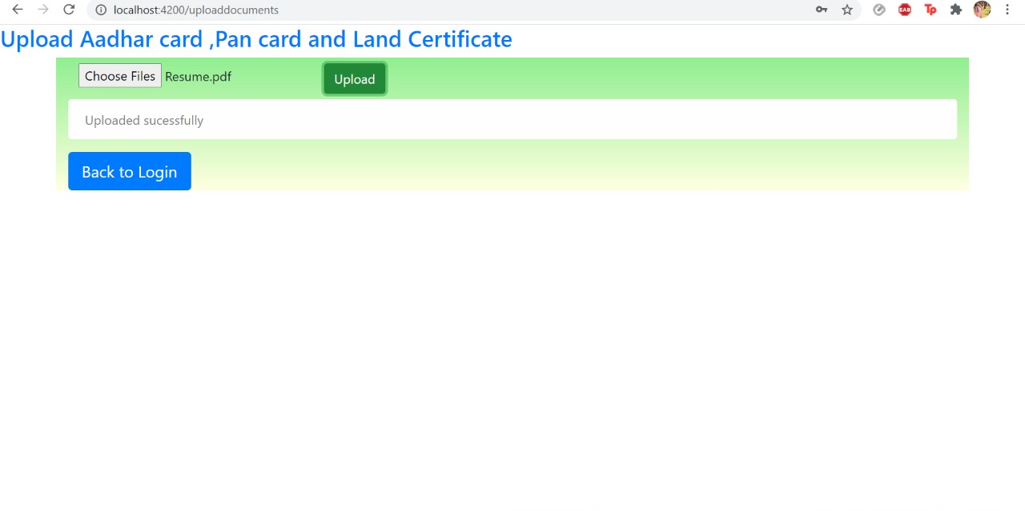

Slide 6
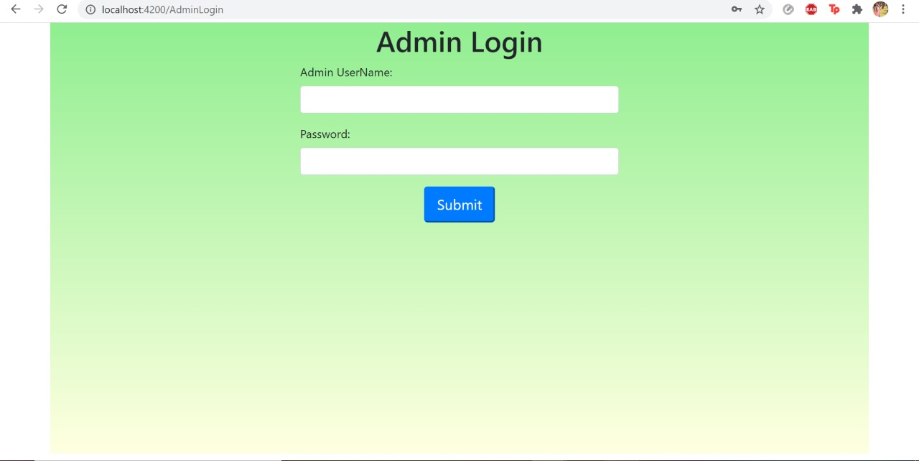

Slide 7
